Slide 1
DP-601T00A: Implementing a Lakehouse with Microsoft Fabric
Notes:
Instructor notes and guidance.
This space has been left deliberately blank

Slide 2


Use Apache Spark in Microsoft Fabric
Notes:
aka.ms/fabric-spark Before delivering this presentation, review the associated module on Microsoft Learn (https://aka.ms/fabric-spark).
The goal of this presentation is to introduce how learners can use Spark in Microsoft Fabric to ingest, process, and analyze data in a lakehouse.
The estimated time to present these slides is 30 minutes.

Slide 3
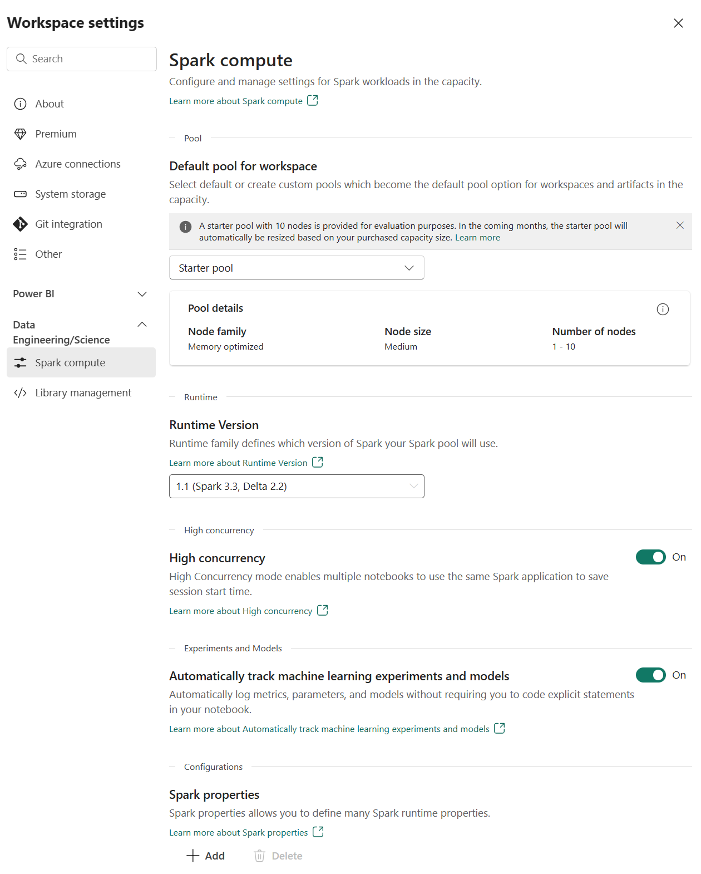
Prepare to use Apache Spark
Each workspace is assigned a Spark cluster.
Workspace admins can manage settings for the Spark cluster in the Workspace settings.
Specific configuration settings include:
Node family
Runtime version
Spark properties
Notes:
Apache Spark is often used in conjunction with a data lake architecture to process and analyze large volumes of data stored in the data lake. Use Spark in Fabric to continue transforming data or to build a machine learning model.
Apache Spark is distributed data processing framework that enables large-scale data analytics by coordinating work across multiple processing nodes in a cluster. Put more simply, Spark uses a "divide and conquer" approach to processing large volumes of data quickly by distributing the work across multiple computers. The process of distributing tasks and collating results is handled for you by Spark.
You submit a data processing job in the form of some code that initiates a driver program, which uses a cluster management object called the SparkContext to manage the distribution of processing in the Spark cluster. In most cases, these details are abstracted - you just need to write the code required to perform the data operations you need.
Spark can run code written in a wide range of languages, including Java, Scala (a Java-based scripting language), Spark R, Spark SQL, and PySpark (a Spark-specific variant of Python). Most data engineering and analytics workloads are accomplished using a combination of PySpark and Spark SQL.
Settings In Microsoft Fabric, each workspace is assigned a Spark cluster. An administrator can manage settings for the Spark cluster in the Data Engineering/Science section of the workspace settings.
Libraries The Spark open source ecosystem includes a wide selection of code libraries for common (and sometimes very specialized) tasks. Since a great deal of Spark processing is performed using PySpark, the huge range of Python libraries ensures that whatever the task you need to perform, there's probably a library to help.

Slide 4
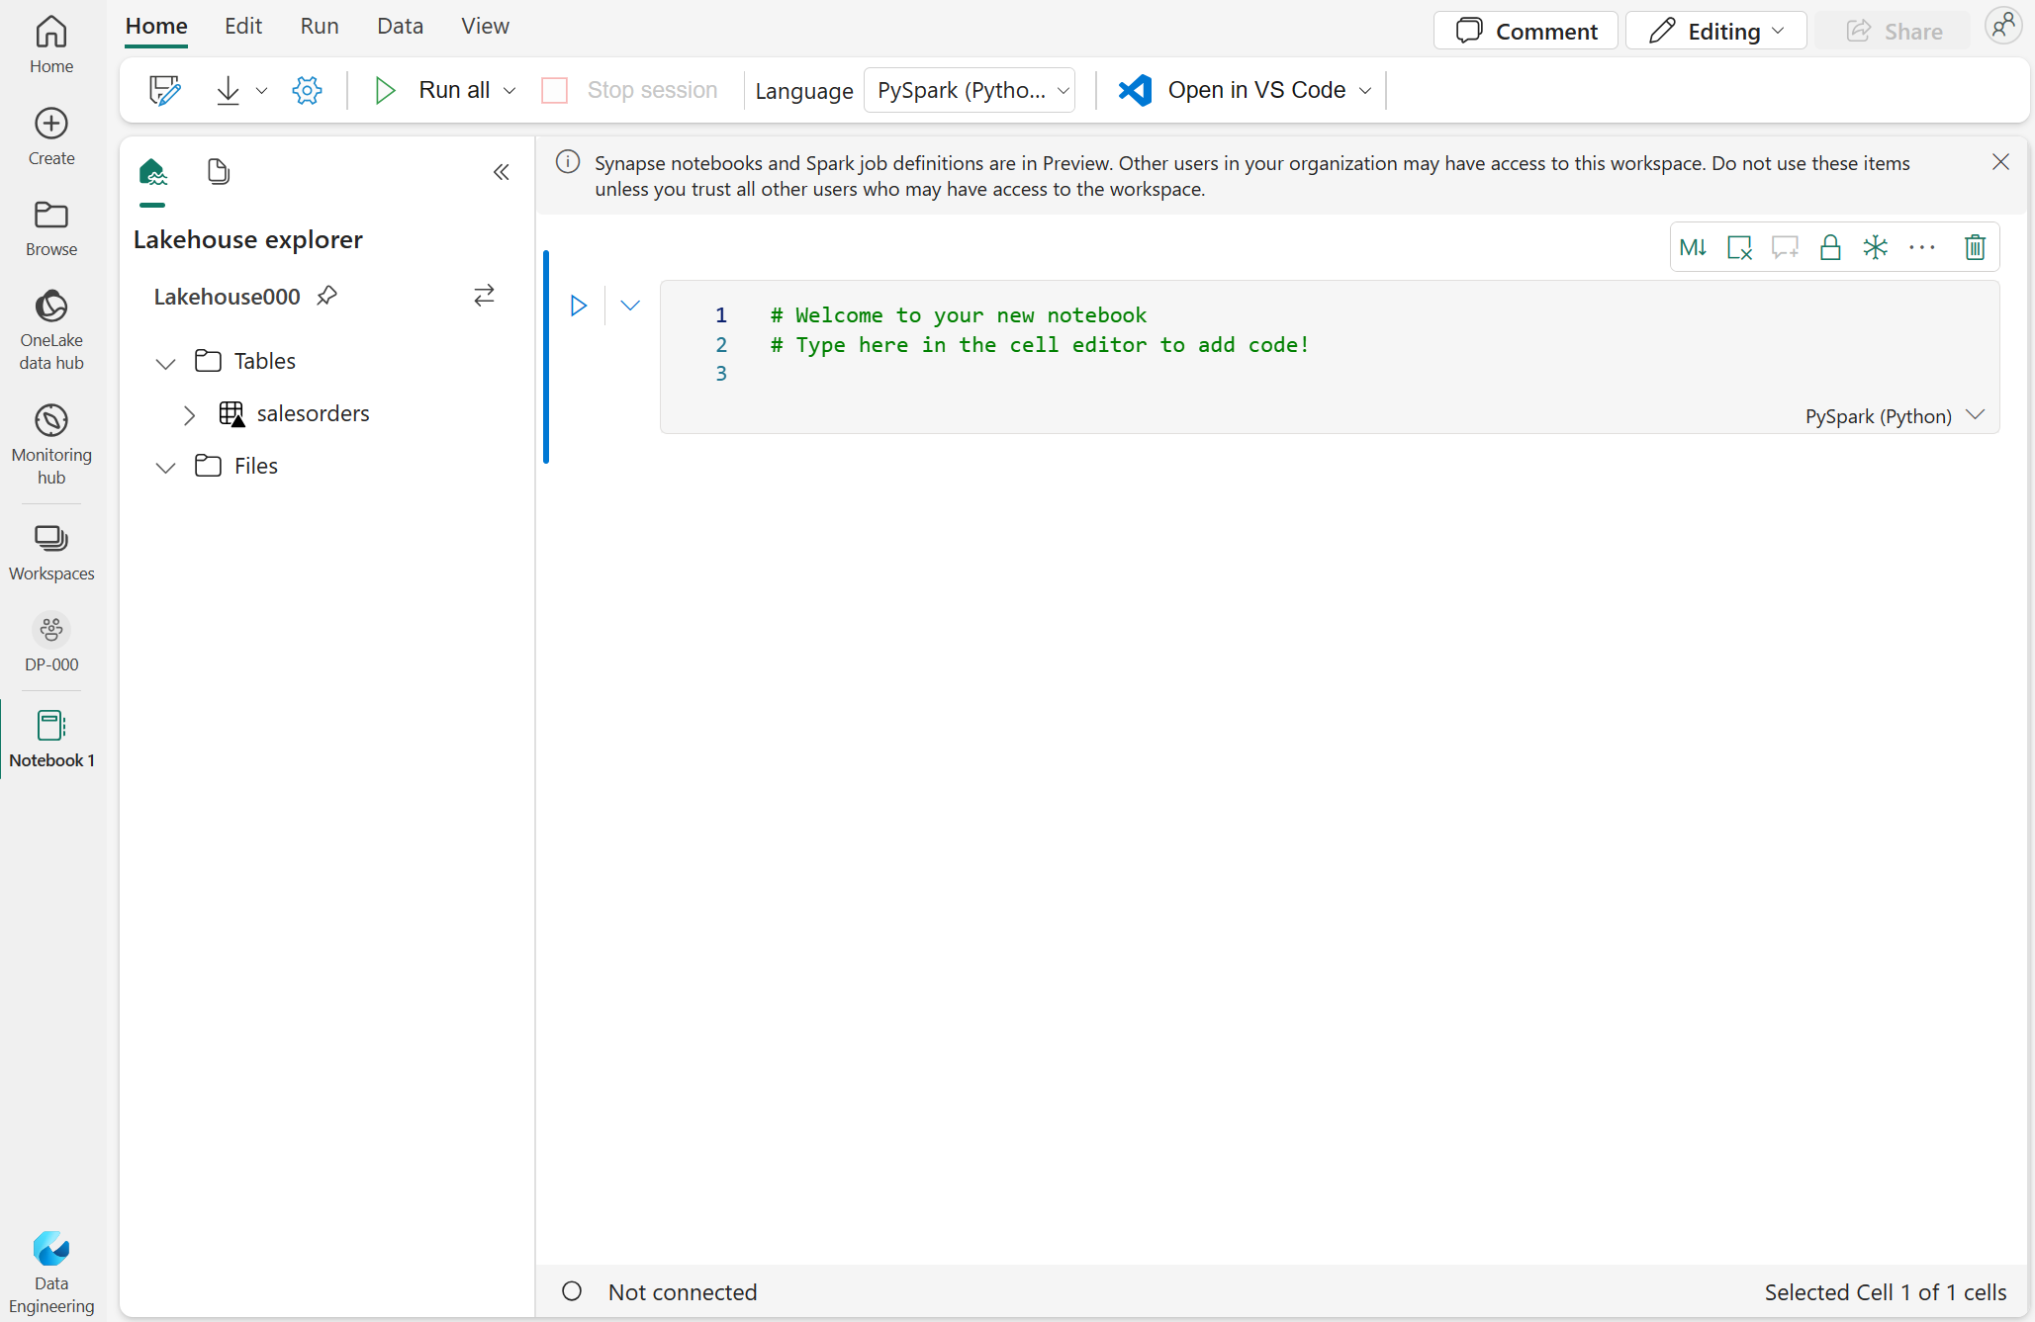
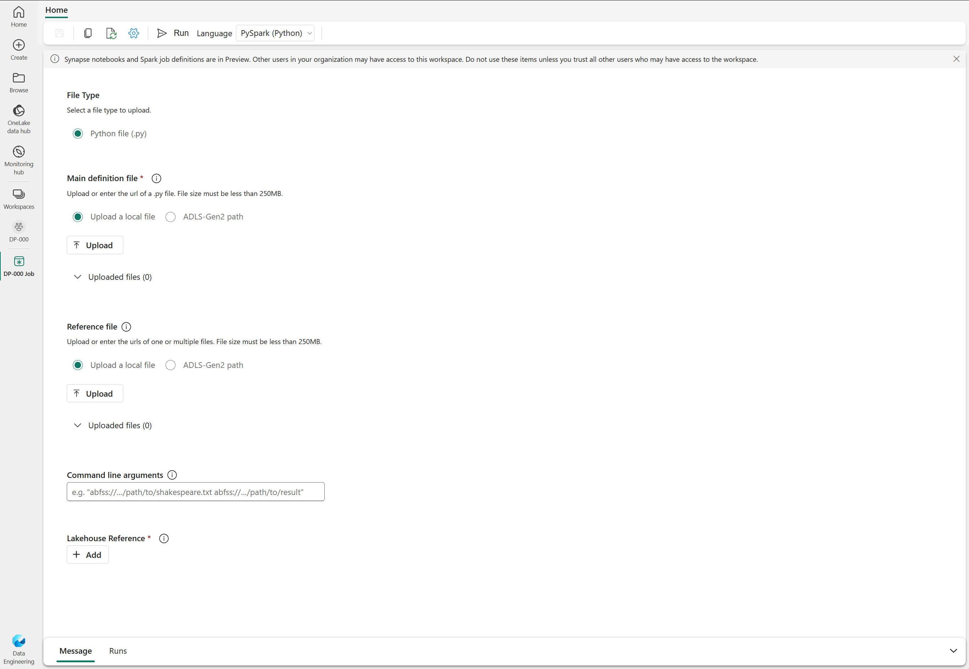
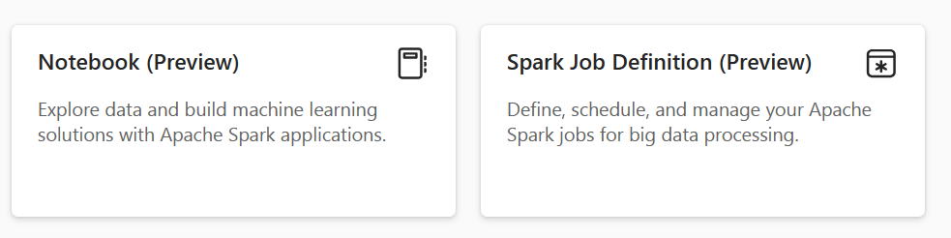
Run Spark in Fabric
To edit and run Spark code in Fabric, use notebooks or create a Spark Job Definition
Non-interactive script run in Spark at a scheduled time
Interactive environment for coding and collaborative notes
Notes:
This is a build slide.
To edit and run Spark code in Microsoft Fabric, you can use notebooks, or you can define a Spark job. Click 1. Run Spark in a notebook
When you want to use Spark to explore and analyze data interactively, use a notebook. Notebooks enable you to combine text, images, and code written in multiple languages to create an interactive artifact that you can share with others and collaborate. Notebooks consist of one or more cells, each of which can contain markdown-formatted content or executable code. You can run the code interactively in the notebook and see the results immediately.
Click
2. Define a Spark job
If you want to use Spark to ingest and transform data as part of an automated process, you can define a Spark job to run a script on-demand or based on a schedule. To configure a Spark job, create a Spark Job Definition in your workspace and specify the script it should run. You can also specify a reference file (for example, a Python code file containing definitions of functions that are used in your script) and a reference to a specific lakehouse containing data that the script processes.

Slide 5
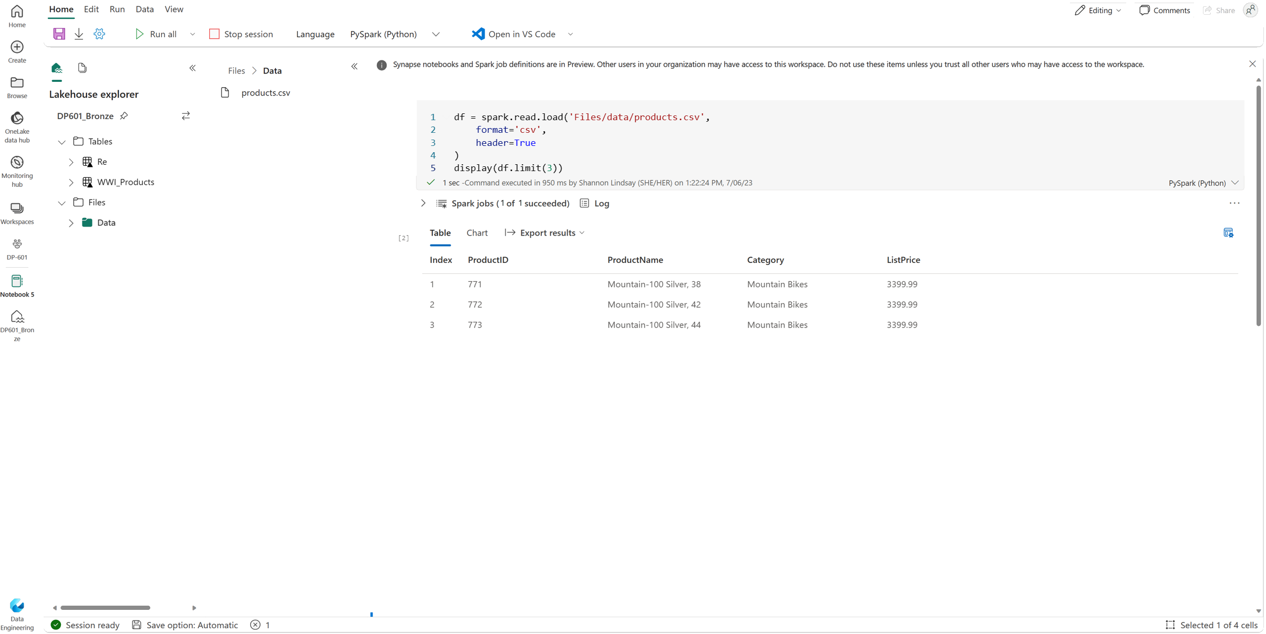
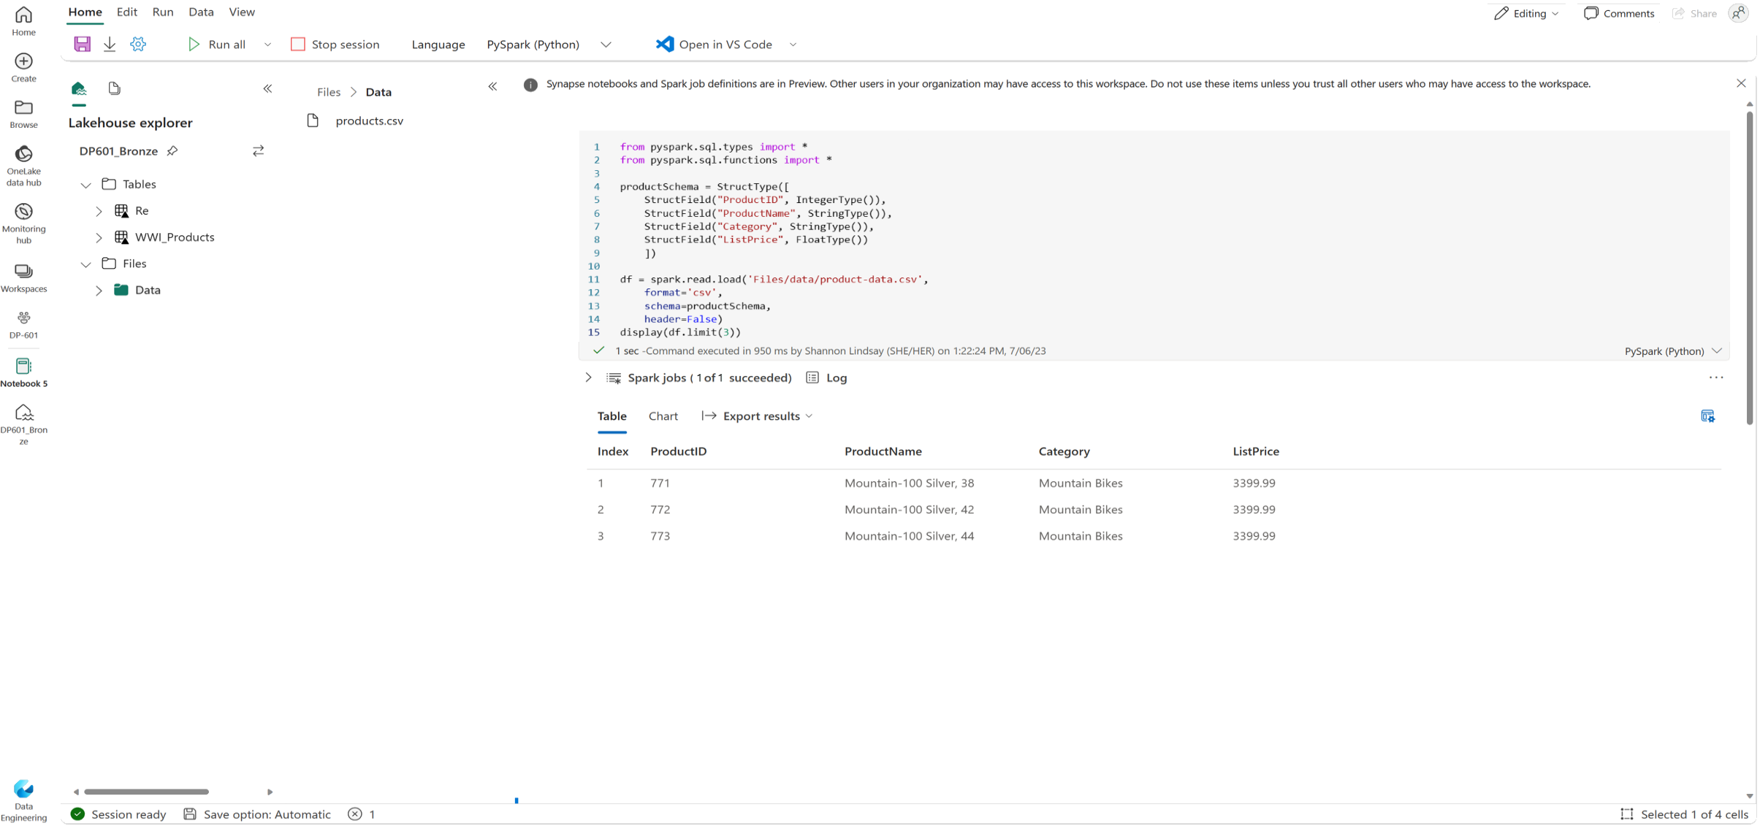
Load data in a Spark dataframe
Schema can be either inferred or specified
Infer a schema
Specify a schema
Notes:
This is a build slide.
Working with data in a dataframe (within a notebook) combines the interactivity of data exploration, expressive data manipulation capabilities, visualizations, collaborative analysis, iterative development, and documentation in a single environment.
Natively, Spark uses a data structure called a resilient distributed dataset (RDD); but while you can write code that works directly with RDDs, the most commonly used data structure for working with structured data in Spark is the dataframe, which is provided as part of the Spark SQL library. Dataframes in Spark are similar to those in the ubiquitous Pandas Python library, but optimized to work in Spark's distributed processing environment.
Inferring a schema
Suppose you have a comma-delimited text file named products.csv in the Files/data folder in your lakehouse. In a Spark notebook, you could use the following PySpark code to load the file data into a dataframe and display the first 10 rows.
The dataframe includes standard functionality for transforming data.
Click to see:
Specifying an explicit schema
In the previous example, the first row of the CSV file contained the column names, and Spark was able to infer the data type of each column from the data it contains. You can also specify an explicit schema for the data, which is useful when the column names aren't included in the data file.

Slide 6
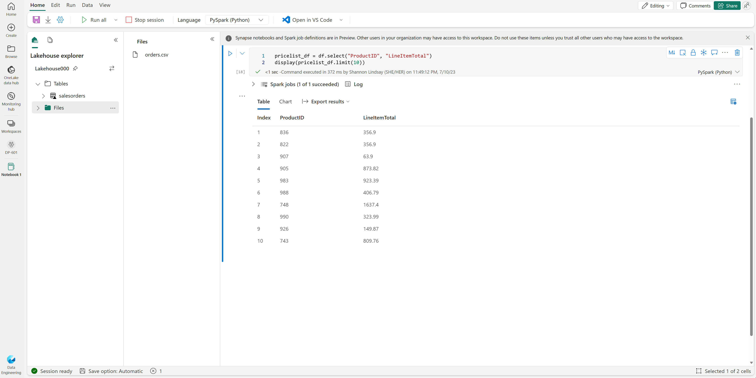
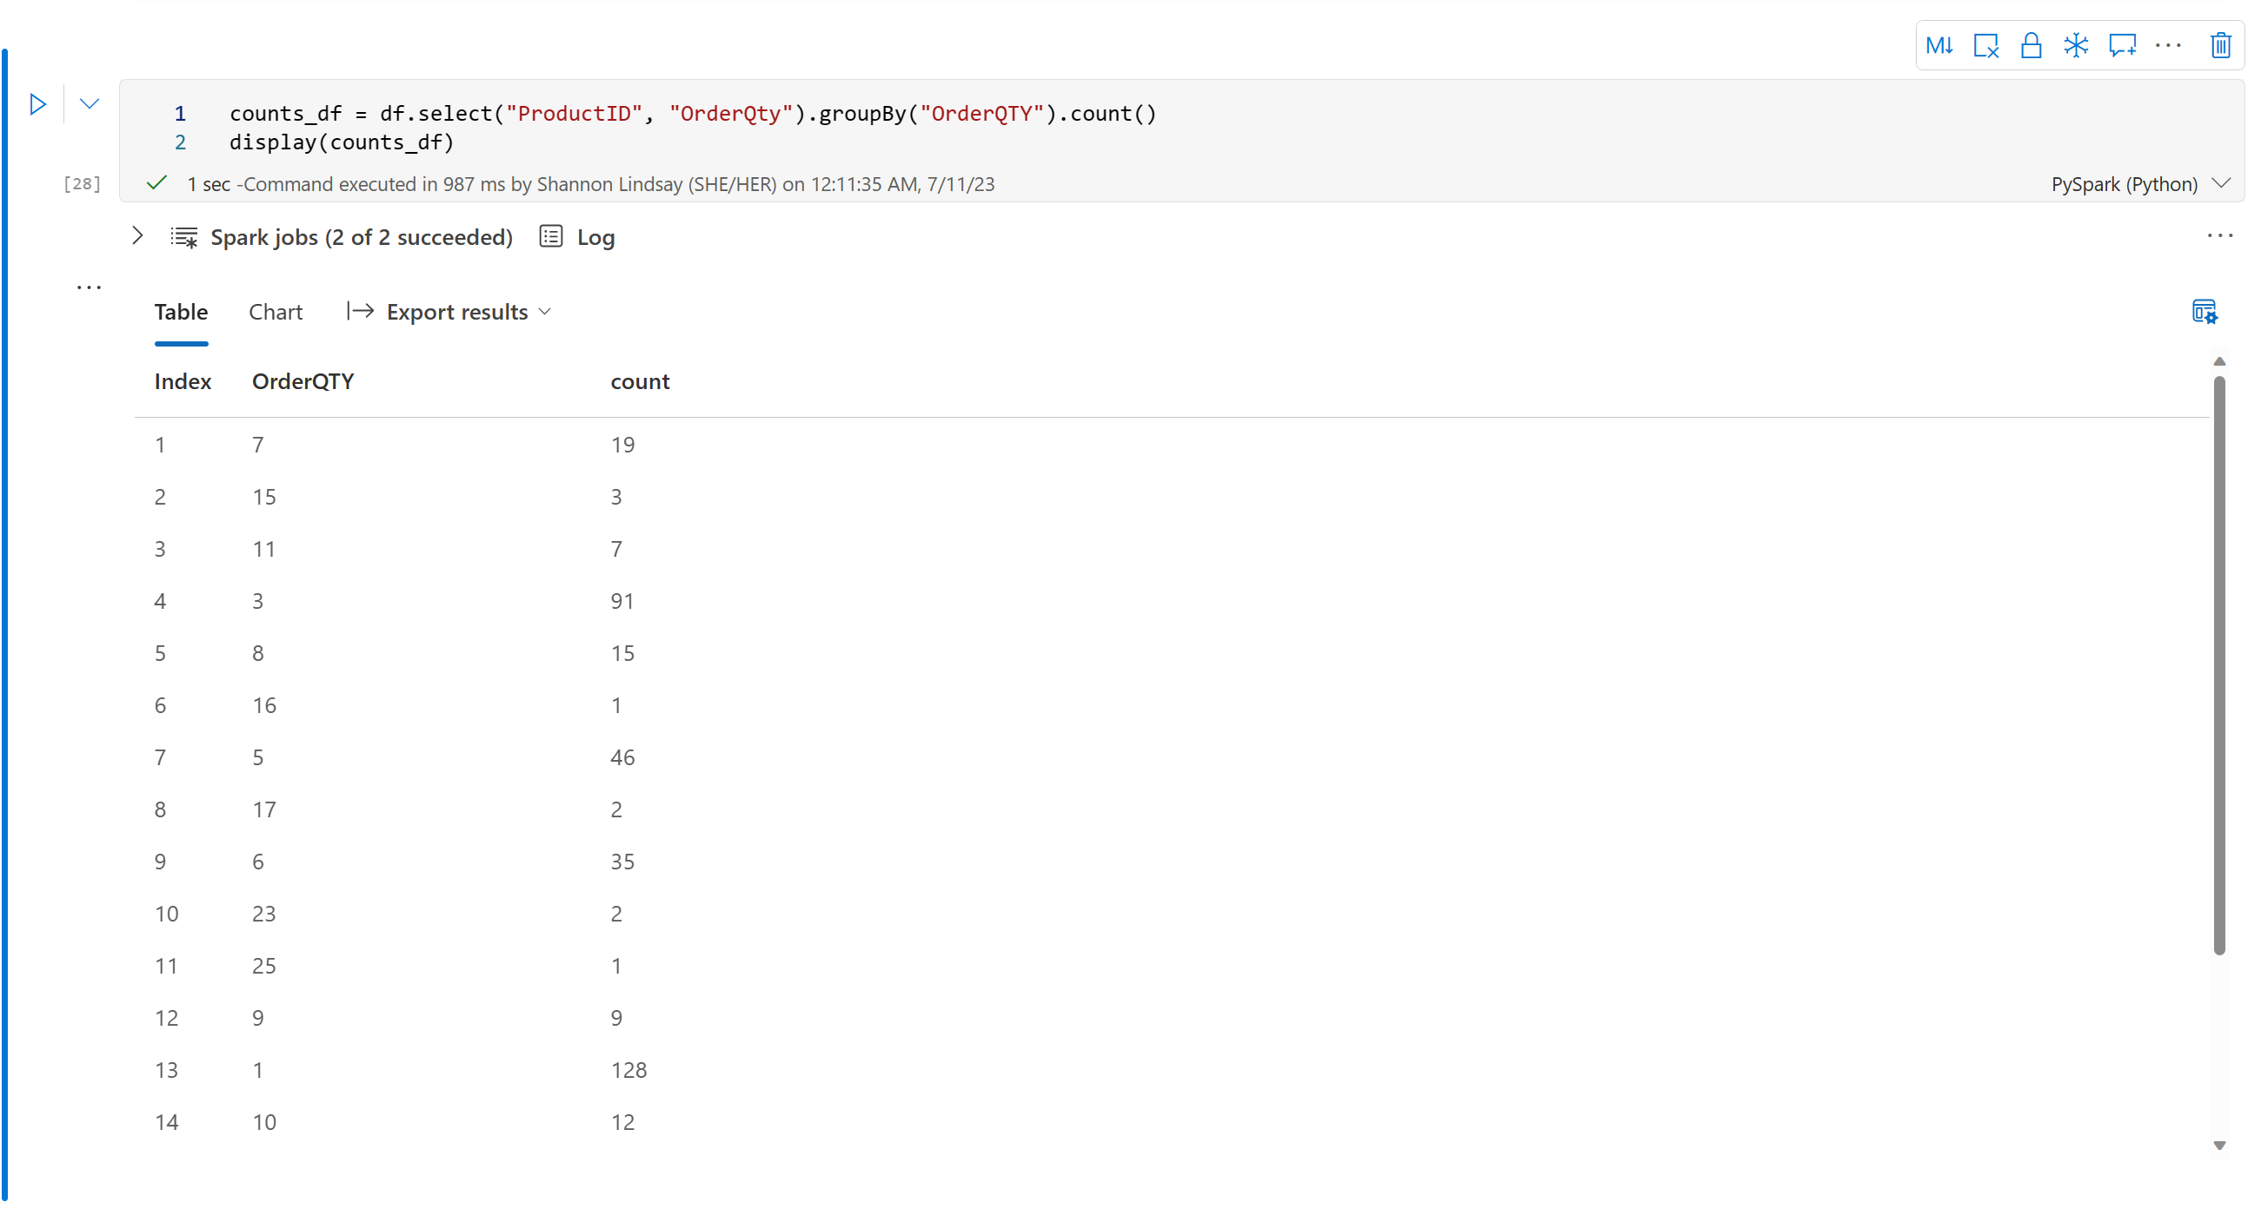
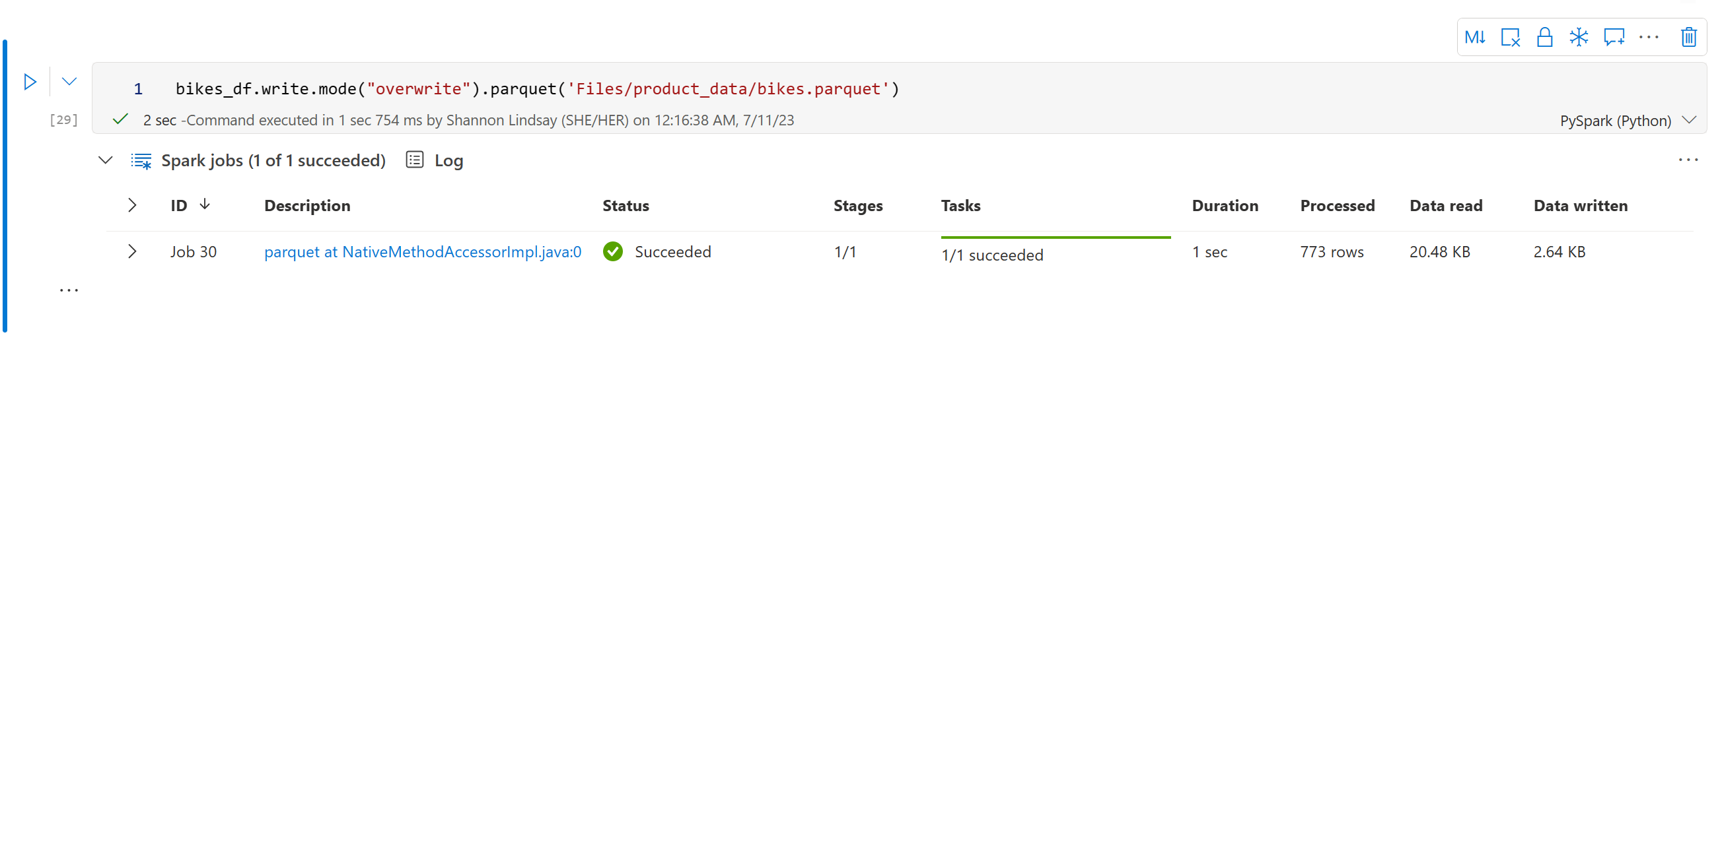
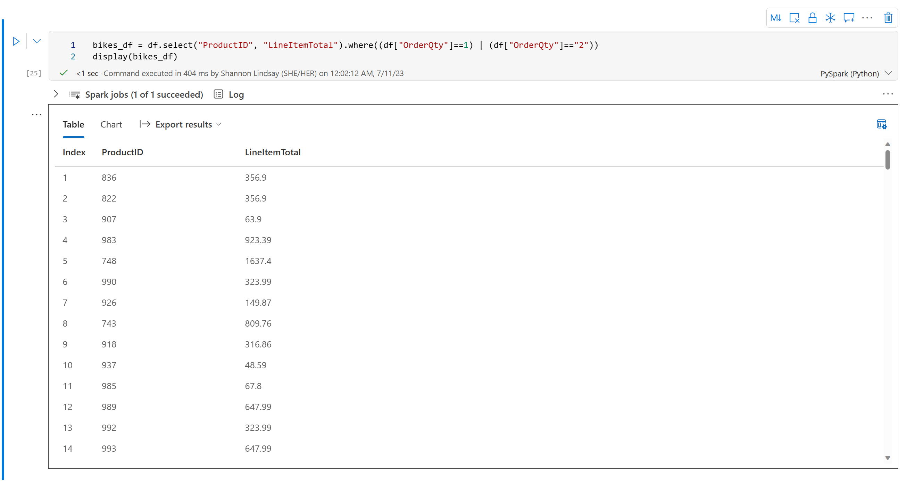
Transform data in a Spark dataframe
Filter and sort data
Save dataframe for further analysis
Group and aggregate data
Chain methods together
Notes:
This is a build slide.
Dataframe methods are functions or operations provided by a dataframe object that allow you to manipulate and analyze data stored in tabular form. Click You can use the methods of the Dataframe class to filter, sort, group, and otherwise manipulate the data it contains. For example, the code example uses the select method to retrieve the ProductID and LineItemTotal columns from the df dataframe containing product data. Click
You can "chain" methods together to perform a series of manipulations that results in a transformed dataframe. For example, this example code chains the select and where methods to create a new dataframe containing the ProductID and LineItemTotal columns for products with a quantity of 1 or 2.
Click To group and aggregate data, you can use the groupBy method and aggregate functions. For example, the following PySpark code counts the number of products for each quantity of orders. Click
You'll often want to use Spark to transform raw data and save the results for further analysis or downstream processing. The code example saves the dataFrame into a parquet file in the data lake, replacing any existing file of the same name.

Slide 7


Partition the output file
Partition data by one or more columns
Distributes data to improve performance and scalability
data
Year=2020
Year=2021
df.write.partitionBy("Year").mode("overwrite").parquet("/data")
Notes:
Partitioning is an optimization technique that enables Spark to maximize performance across the worker nodes. More performance gains can be achieved when filtering data in queries by eliminating unnecessary disk IO. To save a dataframe as a partitioned set of files, use the partitionBy method when writing the data. The following example saves the dataframe, and partitions the data by Year.
Load partitioned data
When reading partitioned data into a dataframe, you can load data from any folder within the hierarchy by specifying explicit values or wildcards for the partitioned fields.

Slide 8
Work with data using Spark SQL
Use the metastore to define tables and views
# Create a view in the metastore
df.createOrReplaceTempView("products_view")
# Save a dataframe as a new table
df.write.format("delta").saveAsTable("products")
Create external tables
# Create external table
df.write.format("delta").saveAsTable("myexternaltable",path="Files/myexternaltable")
Notes:
The Dataframe API is part of a Spark library named Spark SQL, which enables data analysts to use SQL expressions to query and manipulate data.
Creating database objects in the Spark catalog
The Spark catalog is a metastore for relational data objects such as views and tables. The Spark runtime can use the catalog to seamlessly integrate code written in any Spark-supported language with SQL expressions that may be more natural to some data analysts or developers. One of the simplest ways to make data in a dataframe available for querying in the Spark catalog is to create a temporary view.
A view is temporary, meaning that it's automatically deleted at the end of the current session. You can also create tables that are persisted in the catalog to define a database that can be queried using Spark SQL.
Tables are metadata structures that store their underlying data in the storage location associated with the catalog. In Microsoft Fabric, data for managed tables is stored in the Tables storage location shown in your data lake, and any tables created using Spark are listed there.
You can create an empty table by using the spark.catalog.createTable method, or you can save a dataframe as a table by using its saveAsTable method. Deleting a managed table also deletes its underlying data.
Use the metastore to define tables to create a new table based on delta files in an existing folder, use external tables to save the dataframe as a new set of delta files in a location other than the default table store.

Slide 9
Query data using the Spark SQL API
Use the Spark SQL API in code written in any language to query data in the catalog
# Return data from the products table as a dataframe using PySpark
bikes_df = spark.sql("SELECT ProductID, ProductName, ListPrice \
FROM products \
WHERE Category IN ('Mountain Bikes', 'Road Bikes')")
display(bikes_df)
# Use %%sql magic to query objects in the catalog using native SQL
%%sql
SELECT Category, COUNT(ProductID) AS ProductCount
FROM products
GROUP BY Category
ORDER BY Category
Notes:
This is a build slide.
You can use the Spark SQL API in code written in any language to query data in the catalog.
Click to display PySpark code snippet
The displayed PySpark code uses a SQL query to return data from the products table as a dataframe.
Click to display SQL code snippet
In a notebook, you can also use the %%sql magic to run SQL code that queries objects in the catalog.

Slide 10
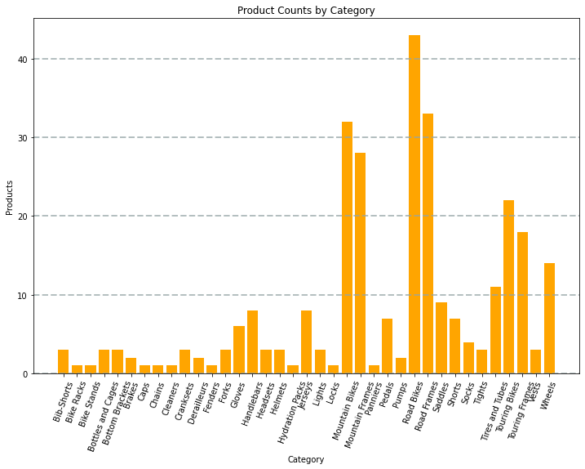
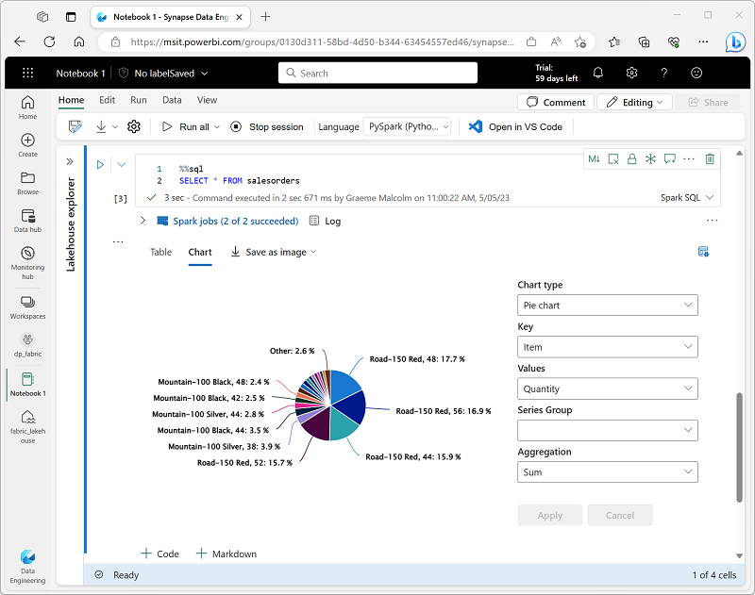
Visualize data
Two ways to visualize data in notebooks:
1. Use built-in notebook charts
2. Use graphics packages in code
- This example uses Matplotlib
Notes:
This is a build slide.
One of the most intuitive ways to analyze the results of data queries is to visualize them as charts. Notebooks in Microsoft Fabric provide some basic charting capabilities in the user interface, and when that functionality doesn't provide what you need, you can use one of the many Python graphics libraries to create and display data visualizations in the notebook. Click
1. Use built-in notebook charts
When you display a dataframe or run a SQL query in a Spark notebook, the results are displayed under the code cell. By default, results are rendered as a table, but you can also change the results view to a chart and use the chart properties to customize how the chart visualizes the data.
Click
2. Use graphics packages in code
There are many graphics packages that you can use to create data visualizations in code. In particular, Python supports a large selection of packages; most of them built on the base Matplotlib library. The output from a graphics library can be rendered in a notebook, making it easy to combine code to ingest and manipulate data with inline data visualizations and markdown cells to provide commentary.

Slide 11
Exercise
Analyze data with Apache Spark
Notes:
https://aka.ms/mslearn-fabric-spark The estimated time to complete this exercise is 45 minutes.

Slide 12

Knowledge check
You want to use Apache Spark to explore data interactively in Microsoft Fabric. What should you create?
A Spark job definition.
A Data Factory pipeline.
A notebook.
You need to use Spark to analyze data in a CSV file. What's the simplest way to accomplish this goal?
Load the file into a dataframe.
Import the data into a table in a warehouse.
Convert the data to Parquet format.
Which method is used to split the data across folders when saving a dataframe?
splitBy
distributeBy
partitionBy
Notes:
Allow students a few minutes to think about the questions, and then use the animated slide to reveal the correct answers.

Slide 13

Further reading
Use Apache Spark in Microsoft Fabric
https://aka.ms/fabric-spark
Notes:
Encourage students to review the online material on Microsoft Learn on which this presentation is based.

Slide 14

Work with Delta Lake tables in Microsoft Fabric
Notes:
https://aka.ms/fabric-delta Before delivering this section, review the associated module on Microsoft Learn (https://aka.ms/fabric-delta).
The goal of this presentation is to provide an introduction to the Delta Lake storage format to create advanced analytics solutions on Microsofr Fabric.
The estimated time to present these slides is 30 minutes.

Slide 15
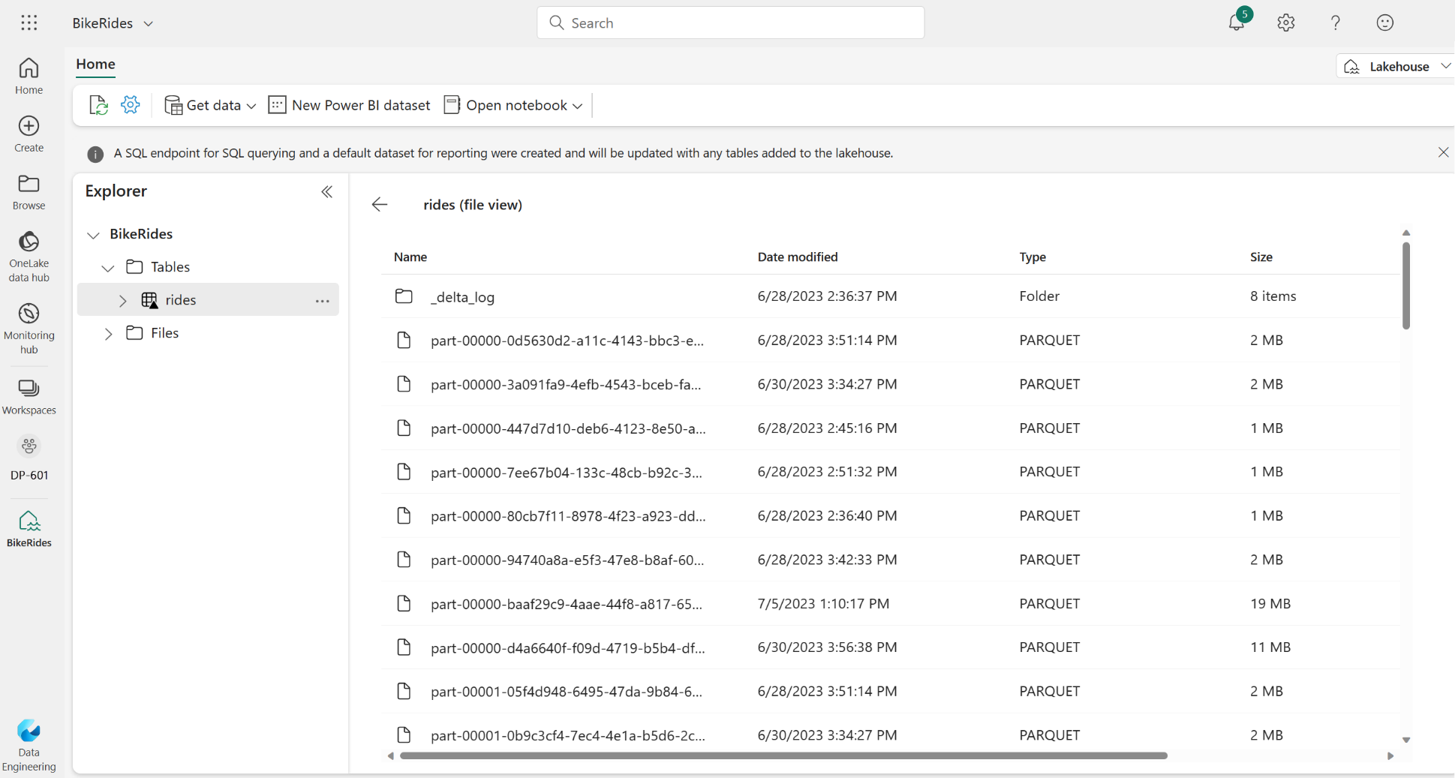
Understand Delta Lake
Relational tables that support querying and data modification
Support for ACID transactions
Data versioning and time travel
Standard formats and interoperability
Notes:
Delta Lake is an open-source storage layer that adds relational database semantics to Spark-based data lake processing. Tables in Microsoft Fabric lakehouses are Delta tables, which is signified by the triangular Delta (▴) icon on tables in the lakehouse user interface.
Delta tables are schema abstractions over data files that are stored in Delta format. For each table, the lakehouse stores a folder containing Parquet data files and a _delta_Log folder in which transaction details are logged in JSON format.
Relational tables that support querying and data modification. With Apache Spark, you can store data in Delta tables that support CRUD (create, read, update, and delete) operations. In other words, you can select, insert, update, and delete rows of data in the same way you would in a relational database system.
Support for ACID transactions. Relational databases are designed to support transactional data modifications that provide atomicity (transactions complete as a single unit of work), consistency (transactions leave the database in a consistent state), isolation (in-process transactions can't interfere with one another), and durability (when a transaction completes, the changes it made are persisted). Delta Lake brings this same transactional support to Spark by implementing a transaction log and enforcing serializable isolation for concurrent operations.
Data versioning and time travel. Because all transactions are logged in the transaction log, you can track multiple versions of each table row and even use the time travel feature to retrieve a previous version of a row in a query.
Support for batch and streaming data. While most relational databases include tables that store static data, Spark includes native support for streaming data through the Spark Structured Streaming API. Delta Lake tables can be used as both sinks (destinations) and sources for streaming data.
Standard formats and interoperability. The underlying data for Delta tables is stored in Parquet format, which is commonly used in data lake ingestion pipelines. Additionally, you can use the SQL Endpoint for the Microsoft Fabric lakehouse to query Delta tables in SQL.

Slide 16
Create delta tables using code in Spark
Save a dataframe as a managed table
# Load a file into a dataframe
df = spark.read.load('Files/mydata.csv', format='csv', header=True) # Save the dataframe as a delta table
df.write.format("delta").saveAsTable("mytable")
Use Spark SQL
%%sql
CREATE TABLE salesorders
(
Orderid INT NOT NULL,
OrderDate TIMESTAMP NOT NULL,
CustomerName STRING,
SalesTotal FLOAT NOT NULL
)
USING DELTA
Save a dataframe in delta format in an explicit path
delta_path = "Files/mydatatable"
df.write.format("delta").save(delta_path)
Notes:
This is a build slide.
When you create a table in a Microsoft Fabric lakehouse, a delta table is defined in the metastore for the lakehouse and the data for the table is stored in the underlying Parquet files for the table.
With most interactive tools in the Microsoft Fabric environment, the details of mapping the table definition in the metastore to the underlying files are abstracted. However, when working with Apache Spark in a lakehouse, you have greater control of the creation and management of delta tables.
Creating a delta table from a dataframe - One of the easiest ways to create a delta table in Spark is to save a dataframe in the delta format.
Use Spark SQL - You can also create delta tables by using the Spark SQL CREATE TABLE statement.
Save in delta format - A third possibility is to save data in delta format without creating a table definition in the metastore. This approach can be useful when you want to persist the results of data transformations performed in Spark in a file format over which you can later "overlay" a table definition or process directly by using the delta lake API.

Slide 17
Managed vs external tables
Managed tables
Defined without a specific location – files are created in the default metastore folder (Tables/…)
Dropping the table deletes the files
# Save a dataframe as a delta table
df.write.format("delta").saveAsTable("mytable")
External tables
Defined with an explicit file location outside of the default metastore folder
Dropping the table does not delete the files
df.write.format("delta").saveAsTable("myexternaltable",path="Files/myexternaltable")
Notes:
This is a build slide.
In managed tables, the table definition in the metastore and the underlying data files are both managed by the Spark runtime for the Fabric lakehouse. Deleting the table will also delete the underlying files from the Tables storage location for the lakehouse.
You can also create tables as external tables, in which the relational table definition in the metastore is mapped to an alternative file storage location.
Click For example, the following code creates an external table for which the data is stored in the folder in the Files storage location for the lakehouse.
Click
In this example, the table definition is created in the metastore (so the table is listed in the Tables user interface for the lakehouse), but the Parquet data files and JSON log files for the table are stored in the Files storage location (and will be shown in the Files section in the Lakehouse explorer pane).

Slide 18
Work with delta tables in Spark
Use Spark SQL to embed a SQL statement in PySpark
Embed SQL statements in other languages using the spark.sql library.
spark.sql("INSERT INTO products VALUES (1, 'Widget', 'Accessories', 2.99)")
Native Spark SQL using %%sql magic
Use %%sql magic in a notebook to run SQL statements.
%%sql
UPDATE products
SET Price = 2.49 WHERE ProductId = 1;
Use the Delta API
Create an instance of a DeltaTable from a folder location containing files in delta format, and then use the API to modify the data in the table.
from delta.tables import *
from pyspark.sql.functions import *
# Create a DeltaTable object
delta_path = "Files/mytable"
deltaTable = DeltaTable.forPath(spark, delta_path)
# Update the table (reduce price of accessories by 10%)
deltaTable.update(
condition = "Category == 'Accessories'",
set = { "Price": "Price * 0.9" })
Notes:
This is a build slide
You can work with delta tables (or delta format files) to retrieve and modify data in multiple ways.
Click
Using Spark SQL - The most common way to work with data in delta tables in Spark is to use Spark SQL. You can embed SQL statements in other languages (such as PySpark or Scala) by using the spark.sql library.
Click
Alternatively, you can use the %%sql magic in a notebook to run SQL statements.
Click
Use the Delta API - When you want to work with delta files rather than catalog tables, it may be simpler to use the Delta Lake API. You can create an instance of a DeltaTable from a folder location containing files in delta format, and then use the API to modify the data in the table.

Slide 19
Data versioning and time travel
Modifications made to delta tables are logged in the transaction log for the table.
You can use the logged transactions to view the history of changes made to the table and to retrieve older versions of the data (known as time travel).
# Use SQL to see the history of a table %%sql
DESCRIBE HISTORY products
# Use SQL to see the history of an external table, specifying folder location
%%sql
DESCRIBE HISTORY 'Files/mytable'
Notes:
This is a build slide.
Use time travel to work with table versioning - Modifications made to delta tables are logged in the transaction log for the table. You can use the logged transactions to view the history of changes made to the table and to retrieve older versions of the data (known as time travel). To see the history of a table, you can use the DESCRIBE SQL command.

Slide 20
Use delta tables with streaming data
Use Delta lake table as a streaming source
from pyspark.sql.types import *
from pyspark.sql.functions import *
# Load a streaming dataframe from the Delta Table
stream_df = spark.readStream.format("delta") \
.option("ignoreChanges", "true") \
.load("Files/delta/internetorders")
# Now you can process the streaming data in the dataframe
# for example, show it:
stream_df.show()
Use Delta lake table as a streaming sink
# Create a stream that reads JSON data from a folder
inputPath = 'Files/streamingdata/'
jsonSchema = StructType([
StructField("device", StringType(), False),
StructField("status", StringType(), False)
])
stream_df = spark.readStream.schema(jsonSchema).option("maxFilesPerTrigger", 1).json(inputPath)
# Write the stream to a delta table
table_path = 'Files/delta/devicetable'
checkpoint_path = 'Files/delta/checkpoint'
delta_stream = stream_df.writeStream.format("delta").option("checkpointLocation", checkpoint_path).start(table_path)
Notes:
Instructor note: this slide exists to let learners know that Delta supports Spark streaming. No need to go into a deep dive.
Streaming is a feature of Delta rather than of Fabric.
Spark Structured Streaming
A typical stream processing solution involves constantly reading a stream of data from a source, optionally processing it to select specific fields, aggregate and group values, or otherwise manipulate the data, and writing the results to a sink.
Spark includes native support for streaming data through Spark Structured Streaming, an API that is based on a boundless dataframe in which streaming data is captured for processing. A Spark Structured Streaming dataframe can read data from many different kinds of streaming source, including network ports, real time message brokering services such as Azure Event Hubs or Kafka, or file system locations. Working with Streaming Data: Delta Lake supports streaming data ingestion and processing. It can efficiently handle real-time data streams by providing scalable and fault-tolerant ingestion and processing capabilities. Streaming data can be continuously appended to a Delta Lake table, and the changes are automatically made available for querying.
Writing Streaming Data to Delta Lake: You can use the Structured Streaming API in Apache Spark to write streaming data to a Delta Lake table. Delta Lake supports the "append" mode, where new data is appended to the table. You can define the input source, schema, and output mode to configure the streaming job.
Handling Late Data and Updates: Delta Lake provides mechanisms to handle late-arriving data and updates in streaming scenarios. You can specify a watermark to discard old data and handle late arrivals. Additionally, Delta Lake supports merge operations to handle updates or upserts to existing data in the Delta Lake table.
Monitoring and Optimizing Streaming Jobs: Monitoring the progress and performance of streaming jobs is essential. Delta Lake provides features like progress reports, metrics, and transaction log management to help monitor and optimize streaming jobs. You can leverage these features to gain insights into the job execution and troubleshoot any issues that may arise.
Data Retention and Table Maintenance: Delta Lake allows you to manage the retention policy for data in the table. You can configure the retention period or apply partition pruning to optimize storage costs. Delta Lake also supports table optimization operations, such as vacuuming and optimizing the transaction log, to improve query performance and manage storage efficiently.

Slide 21
Exercise
Use delta tables in Apache Spark
Notes:
https://aka.ms/mslearn-fabric-delta The estimated time to complete this exercise is 40 minutes.

Slide 22
Knowledge check
Which of the following descriptions best fits Delta Lake?
A Spark API for exporting data from a relational database into CSV files.
A relational storage layer for Spark that supports tables based on Parquet files.
A synchronization solution that replicates data between SQL Server and SPark.
You've loaded a Spark dataframe with data, that you now want to use in a delta table. What format should you use to write the dataframe to storage?
CSV
PARQUET
DELTA
You have a managed table based on a folder that contains data files in delta format. If you drop the table, what happens?
The table metadata and data files are deleted.
The table definition is removed from the metastore, but the data files remain intact.
The table definition remains in the metastore, but the data files are deleted.
Notes:
Allow students a few minutes to think about the questions, and then use the animated slide to reveal the correct answers.

Slide 23
Further reading
Work with Delta Lake tables in Microsoft Fabric
https://aka.ms/fabric-delta
Notes:
Encourage students to review the online material on Microsoft Learn on which this presentation is based.

